Slide 1
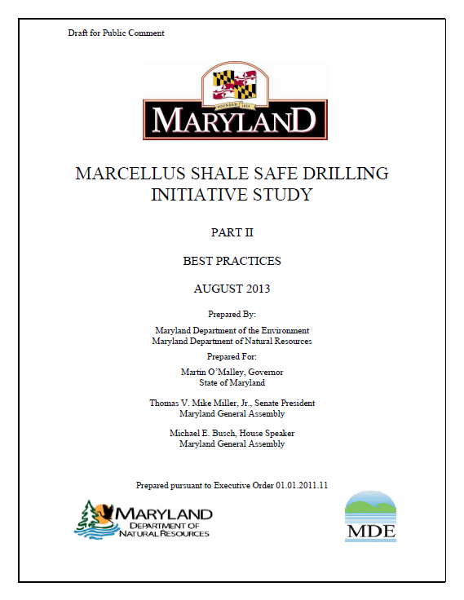
Hydraulic Fracturing
Best Management Practices Comments and Considerations
Presented By:
Michael E. Parker, P.E.
Parker Environmental and Consulting, LLC
February 10, 2014

Slide 2
Presentation Outline
API Standards, Practices and Guidance
Comprehensive Gas Development Plan
Disclosure
Location Restrictions, Water Reuse
Well Integrity
Methane in Groundwater
Groundwater Protection
Other Issues and Comments
Questions

Slide 3
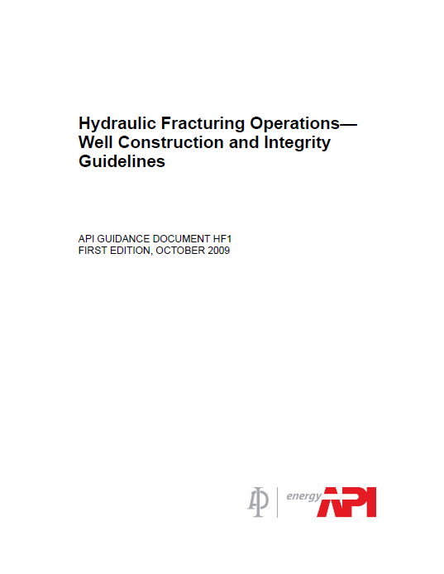
API Standards, Practices and Guidance
±170 API Standards, Practices or Guidance apply
Equipment and materials
Facility and system design
Operational practices
Transparent process
Proven engineering and operational practices
Performance based approach
3 Guidance documents developed specifically for Hydraulic Fracturing Operations (HF Series)
HF-1 Well Construction and Integrity
HF-2 Water Management Associated with Hydraulic Fracturing
HF-3 Practices for Mitigating Surface Impacts Associated with Hydraulic Fracturing
HF Series currently being upgraded and adding Community Engagement document

Slide 4
Comprehensive Gas Development Plan and Disclosure
CGDP
Recommend a two step process:
Exploration Plan
Development Plan
More consistent with existing law, which uses exploration permit and development permit approach
Utilize expedited permitting for activities identified and approved in the CGDP
2 year baseline monitoring requirement questionable
Disclosure
BMP does not adequately address complexities of pre-job disclosure
Consider a clearinghouse approach for pre-job disclosure
Post-job disclosure
FracFocus works
Incorporate use into rules
Protection of IP is critical throughout the process

Slide 5
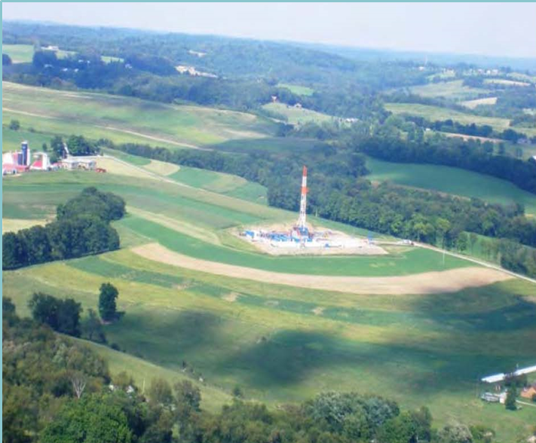
Location Restrictions and Water Reuse
Setbacks
Sound technical basis
Arbitrary setbacks unreasonably limit development
Flexibility
Consider site specific conditions
Develop in conjunction with mitigation and controls
Water Reuse
90% Reuse requirement will be difficult in some cases
“On-site” reuse requirement is unworkable
Operations processes and logistics prohibit
Unintended consequence of larger pads

Slide 6
Well Integrity
Design basis - groundwater protection, formation isolation, pressure containment.
Multiple API Standards and Practices apply
Consider earlier failure data in context.
Not all “FAILURES” are failures.
Risk characterization critical
Regulatory issues
Old wells
Integrity verification and monitoring
Corrosion protection
Monitoring
Diagnostic tools
Maintenance

Slide 7
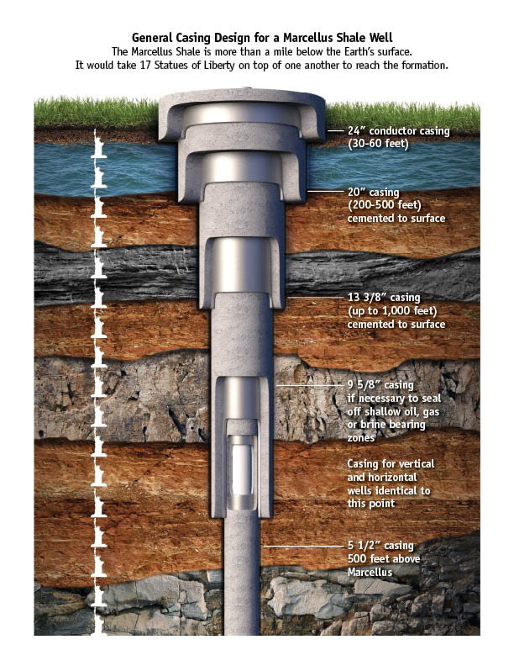
Methane in Groundwater
Methane in groundwater occurs naturally
40-60% incidence rate (Marcellus)
Many events historically noted
Well integrity critical
Cementing procedures – API 65-2
Cement design and testing
Well cleaning and preparation
Centralizer use
Pumping procedures
Regular well monitoring

Slide 8
Groundwater Protection
Contamination scenarios offered are extremely unlikely given operational practices
Pressure and energy are not applied continuously
Fracture length studies verify zonal isolation and groundwater protection
Casing and cement are sound, durable barriers
Operators must exercise due diligence
Identify and ensure wells within AOR don’t pose a risk

Slide 9
Barnett Shale Groundwater Study
Concerns
Well selection process not random
Reference wells not representative
Too few (9)
5/9 out of area
9/9 not in the same aquifer
Also had elevated levels compared to historical data
Implied pollution sources not characterized
Potential for drought impacts appear to be minimized
More questions than conclusions
“…we are unable to determine the ultimate source of these elevated concentrations directly.”
“…our discussion of the source of elevated constituents is speculative…”
“…natural gas extraction activities do not result in systematic contamination of groundwater.”

Slide 10
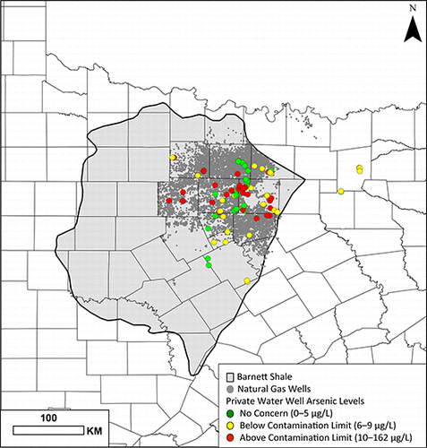
Barnett Shale Study Area

Slide 11
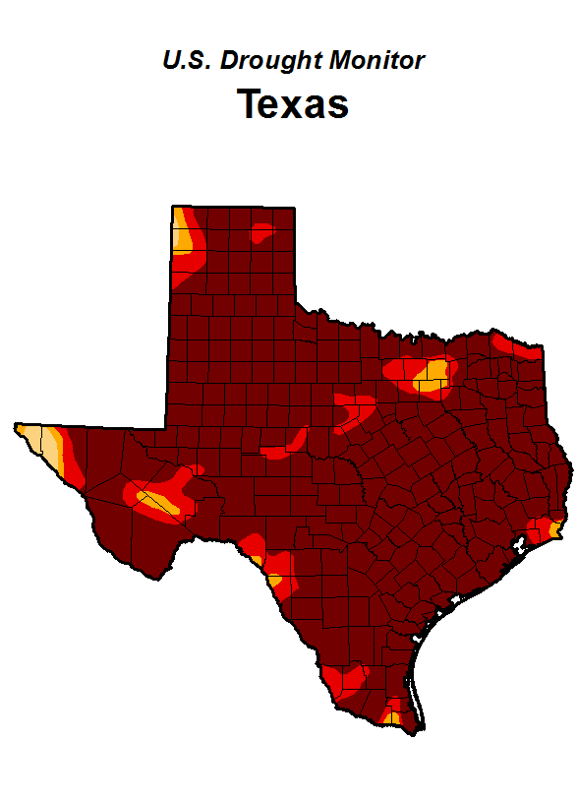
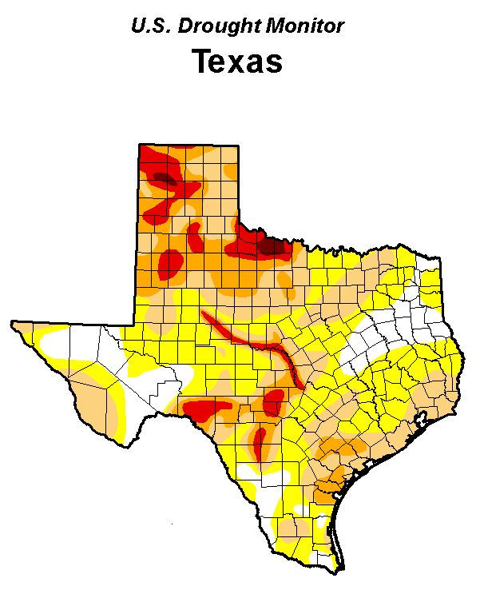
2011 vs. 2014 Drought Conditions
2011
2014

Slide 12
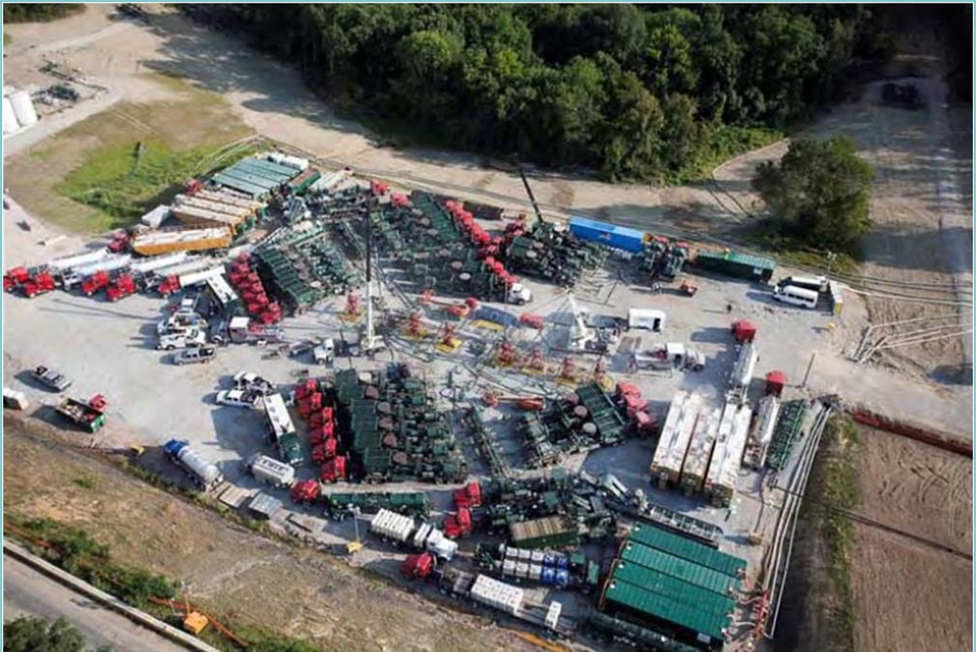
Other Issues

Slide 13
Questions
Michael E. Parker, P.E.
Parker Environmental and Consulting, LLC
ParkerEnC@gmail.com
(832) 581-5474
Drew Cobbs
Maryland Petroleum Council
Cobbsd@api.org
(410) 269-1850
To Learn More:
www.api.org
www.energyfromshale.org
Drilling Video
http://www.youtube.com/watch? v=AYQcSz27Xp8&feature=relmfu
Fracturing Video
http://www.youtube.com/watch?v=7ned5L04o8w

